Slide 1
KIET Group of Institutions, Ghaziabad
Major Project Presentation
Clustering Mutual Funds Using Unsupervised Learning
Group ID: PCSE25-20
Chaitanya Keshari (2100290100047)
Raj Verma (2100290100127)
Ayush Anand (2100290100040)
Date of Presentation: 26/05/2025
Project Guide: Dr. Saurav Chandra (Associate Professor)
1

Slide 2
KIET Group of Institutions, Ghaziabad
Problem Statement
Conventional Fund Classification Issues:
Traditional labels (e.g., Large-Cap, Balanced) are often marketing-oriented.
They fail to reflect the actual risk-return behaviour of mutual funds.
Misleading labels may result in poor investment decisions.
Need for Change:
A fact-based, performance-driven categorization method is required.
2

Slide 3
KIET Group of Institutions, Ghaziabad
Solution
Proposed Approach:
Use unsupervised machine learning (K-Means, Hierarchical Clustering, DBSCAN).
Re-classify funds using performance indicators: Alpha, Beta, Sharpe Ratio, Standard Deviation.
PCA used for dimensionality reduction and improved interpretability.
Evaluate clusters using Silhouette Score and Davies-Bouldin Index.
3

Slide 4
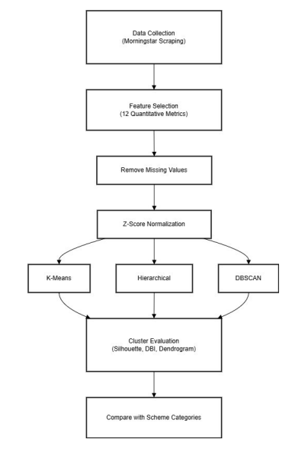
KIET Group of Institutions, Ghaziabad
4

Slide 5
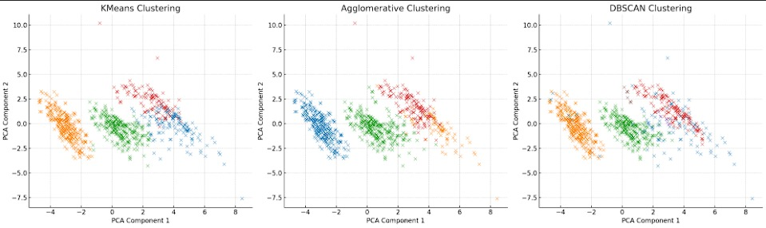
KIET Group of Institutions, Ghaziabad
5

Slide 6
KIET Group of Institutions, Ghaziabad
Project Objectives
Our 4 Major Objectives of our project are:-
Develop a Performance-Based Classification System: Create a data-driven approach to classify mutual funds using key financial indicators such as Alpha, Beta, Sharpe Ratio, and Standard Deviation, instead of relying on traditional AMC labels.
Apply Unsupervised Machine Learning Algorithms: Utilize K-Means, Agglomerative Hierarchical Clustering, and DBSCAN to group mutual funds based on their statistical behaviour and identify inherent clusters.
Evaluate Cluster Quality with Internal Metrics: Assess the validity and cohesion of clusters using metrics like Silhouette Score and Davies-Bouldin Index to ensure meaningful segmentation.
Compare Cluster-Based Groups with Traditional Categories: Analyze the overlap and discrepancies between machine-learned clusters and existing AMC classifications to detect potential mislabeling or inconsistencies.
Notes:
Immersive and Interactive Learning, Personalized and Gamified Education, Comprehensive Anatomy Knowledge, Enhanced Visualization and Exploration

Slide 7
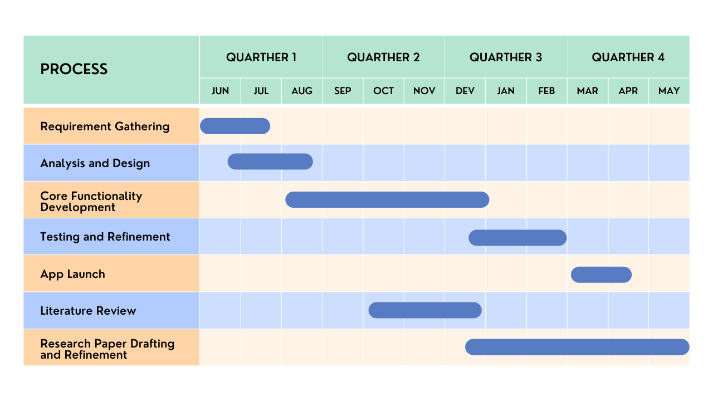
KIET Group of Institutions, Ghaziabad
Project Timeline
7

Slide 8
KIET Group of Institutions, Ghaziabad
Literature Review
Foundations & Techniques:
Chen et al. (2022) – ML for Fund Performance Evaluation * Used XGBoost, LightGBM, and Random Forest to identify skilled fund managers. * Found CVaR more predictive than traditional Sharpe Ratio. * Relevance: Supports the use of advanced ML for financial behavior analysis.
Shah et al. (2022) – Graph-Based Recommendation Systems * Introduced GraphDCF for mutual fund recommendations with explainable AI. * Used user preference and fund characteristics in a knowledge graph. * Relevance: Highlights the importance of explainability and personalization.
Abbas (2025) – Robo-Advisors with RegTech Integration * Explored combining AI-driven fund suggestions with regulatory compliance. * Relevance: Shows potential to integrate unsupervised clustering in robo-advisory systems for compliant and scalable solutions.
8

Slide 9
KIET Group of Institutions, Ghaziabad
Clustering & Forecasting:
Xiaofei Chen et al. (2021) – Hybrid Clustering & Deep Learning * Combined Gaussian Mixture Models (GMM) with CNN-LSTM-ResNet for price prediction. * Clustering improved prediction accuracy by reducing intra-group variability. * Relevance: Justifies clustering as a preprocessing step for better financial forecasting.
Tao et al. (2019) – Mutual Fund Classification using ML * Compared clustering techniques like K-Means and DBSCAN for fund grouping. * Found data-driven classifications more reliable than AMC labels. * Relevance: Directly supports the methodology of this project.
Discussion:
The reviewed studies consistently support using machine learning and clustering to improve financial classification, personalization, and predictive accuracy. Your project aligns well with these trends by applying unsupervised learning for more accurate and investor-friendly fund categorization.
9

Slide 10
KIET Group of Institutions, Ghaziabad
References
Sakakibara, Y., Matsui, H., & Sakai, H. (2015). "Mutual fund classification using clustering techniques based on investment similarity." Journal of Investment Research, vol. 22, pp. 112–130.
Lisi, F., & Otranto, E. (2010). "Clustering mutual funds using return and volatility characteristics." European Financial Management, vol. 16, no. 3, pp. 442–469.
Tao, Q., Wang, Y., & Li, S. (2019). "Machine Learning in Mutual Fund Classification: A Comparative Study." Journal of Finance and Data Science, vol. 5, no. 1, pp. 1–15.
Jain, A.K., & Dubes, R.C. (1988). "Algorithms for Clustering Data." Prentice-Hall, Englewood Cliffs, NJ.
Kaufman, L., & Rousseeuw, P. J. (2009). Finding Groups in Data: An Introduction to Cluster Analysis. John Wiley & Sons.
Morningstar India, “Mutual fund performance metrics,” Accessed: Jan. 2025. [Online]. Available: https://www.morningstar.in/

Slide 11
KIET Group of Institutions, Ghaziabad
Thank You

